Slide 1




CURING
SOULS
Guide: Dr Silambarasan E sir
Reviewer: Dr Satish Kumar sir

Slide 2





OUR TEAM
Group 147
Utkarsh Singh
20BCE10111
Srishti Saxena
20BCE10315
Nivedita Kokil
20BCE10341
Ayush Yadav
20BCE10947
Anushka Singh
20BCE10371

Slide 3



SELF CARE IS HOW YOU TAKE YOUR POWER BACK

Slide 4

INTRODUCTION
Mental health includes our emotional, psychological, and social well-being. It affects how we think, feel, and act.
Over the course of your life, if you experience mental health problems, your thinking, mood, and behavior could be affected.
Many factors contribute to mental health problems, including:
Biological factors, such as genes or brain chemistry
Life experiences, such as trauma or abuse
Family history of mental health problems
Everyone has some risk of developing a mental health disorder, no matter their age, gender, income, or ethnicity.

Slide 5
EXISTING WORK WITH LIMITATIONS
Mental health is a major concern worldwide and India is not far behind in sharing this. If we evaluate developments in the field of mental health, the pace appears to be slow.
One of the major reasons attributed to such a wide treatment gap is the problem of inadequate resources. In India, inadequacy exists in infrastructure as well as in human resources. Despite improvements in various health indicators, India contributes disproportionately to the global burden of disease.
Given here is a chart which shows components of mental health literacy.

Slide 6

PROPOSED WORK AND METHODOLOGY
basic solutions for mental stress & depression issues
meditation sessions,
mind relaxing events
Information on any nearby therapists
A chat bot for easy communication

Slide 7
NOVELTY OF PROJECT
Simply putting, mental health is greatly neglected in India. People are not aware of the fact that having a fit mind is extremely important to survive. We through our website want to connect people both who seek help and those who want to help.
Our website will be interactive.
Basic test will be taken to estimate a person’s mental state. And also help them self evaluate.
Emergency helplines, and steps to be taken in chronic situations will be discussed.
Therapist recommendations near the patient.

Slide 8
REAL TIME USAGE
Accessing mental health websites help people understand and recognize mental health difficulties, and to start making the steps towards recovery. Support them with their mental health journey by sharing our recommended mental health websites.
It will help with:
recognition of signs and symptoms
improving attitudes to self-help and help-seeking
Basic remedies are provided
Medical help suggestion (therapist nearby)

Slide 9
REAL TIME USAGE
Mental health websites include applications to help you cope with negative emotions, connect with therapists, keep a journal, relieve anxiety and stay mindful. You can also find medication guides, moderated communities and online courses that can help you manage mental illness and improve your mood.
Websites can help you take control of your mental health and find the collection of strategies that can help you feel better.

Slide 10



SOFTWARES USED
Vs Code
Figma
Lucid Chart
Adobe
Illustrator

Slide 11
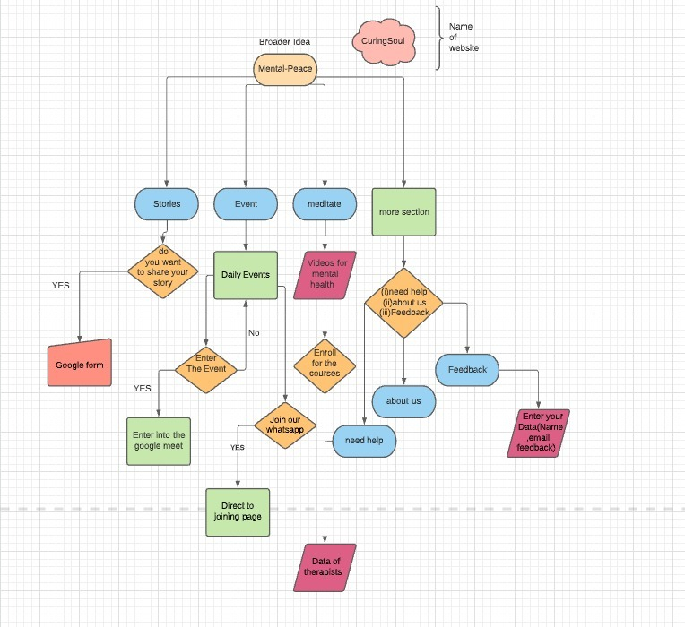
SYSTEM ARCHITECTURE DIAGRAM

Slide 12
LITERATURE REVIEW
The study on psychopathology of depression has found higher risk for recurrence of depression in patients with persistence of cognitive abnormality, notwithstanding clinical remission.
Yoga and spirituality is our Indian national wisdom, and this has been acknowledged by the world community and the United Nations.
The concept of quality of community life (QOCL) has assumed special significance in the medical field in the wake of progressive move towards rehumanizing high-tech medicine.

Slide 13

MOLULE DESCRIPTION
Stories
Event
Home
Meditate

Slide 14
HOME
It encompasses the overall layout with different components leading to rest of the website.
We made sure to embody a stress-relieving environment by opting for soothing and bright colors to make sure the people suffering feel mellow and welcomed.

Slide 15
STORIES
As to cater to every need of our visitors, this sections provides a vast array of videos, audios and imagery.
Multiple Ted Talks, podcasts where survivors go through their inspiring yet hard fought battles have been linked in this section.
Users will also be able to share their inner thoughts or stories which will be for others to see, as we thought it would be inspirational.

Slide 16
EVENT & MEDITATE
Details of any forthcoming events in relation with mental health like various workshops, campaigns, community gatherings or conferences will be displayed under the events tab.
When it comes to help with stress and anxiety meditation comes handy. Types of meditation and its benefits etc are some of the areas we have focused on under meditate.

Slide 17
MORE
Firstly, a feedback form for our users to fill up where they can rate their overall experience with our platform. They can drop by any ideas or other critique in the message box at the bottom of our form alongside their details.
Need help: Users can find names and numbers of reputed psychologists, psychiatrists if they decide of seeking professional help.
About us: We have tried to put a face to the website and explain our main motto, featuring the names of our creative team.

Slide 18
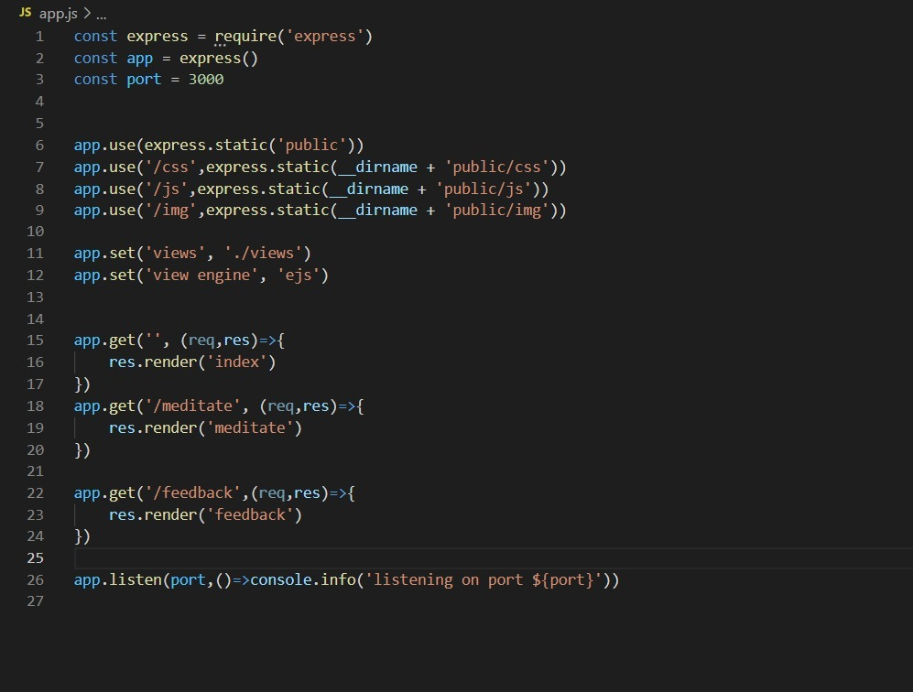
IMPLEMENTATION CODING

Slide 19
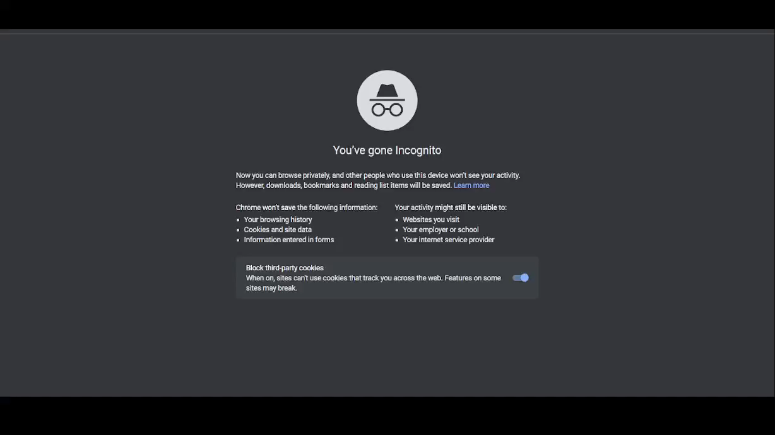
DEMO

Slide 20
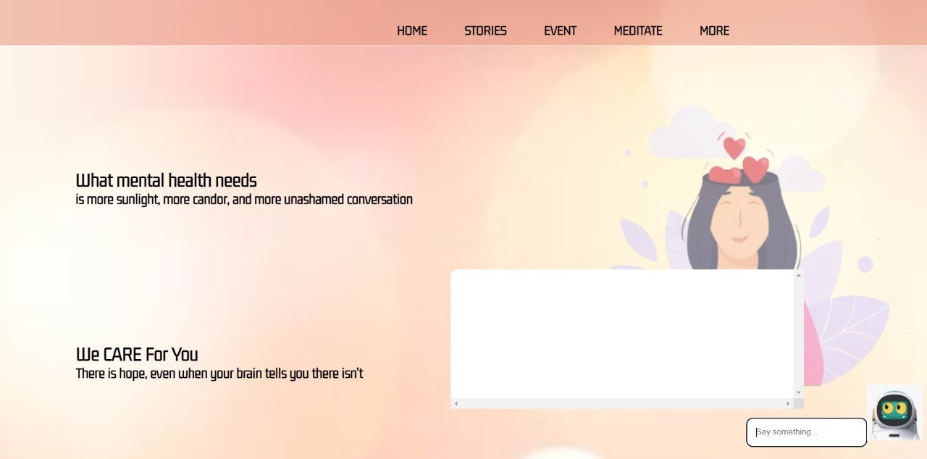
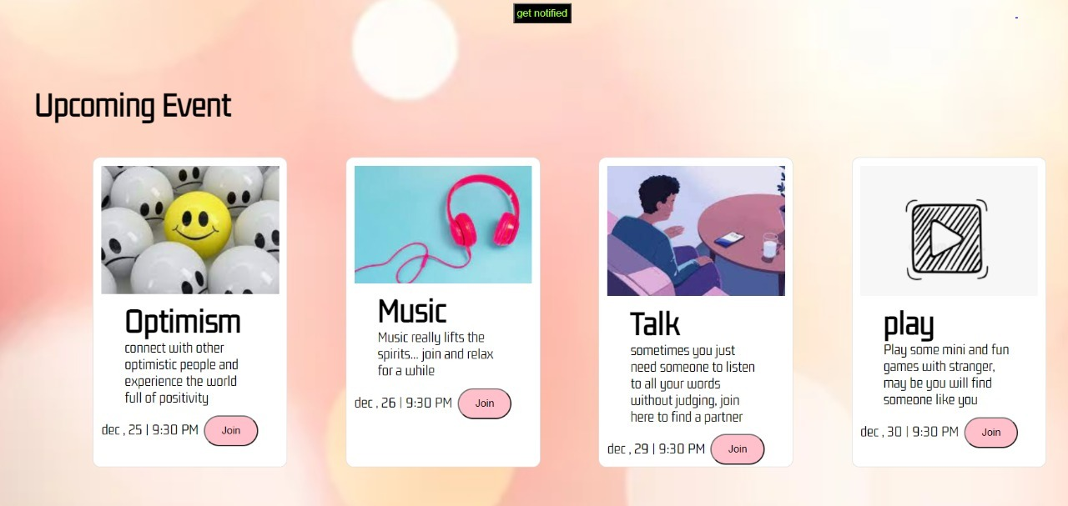
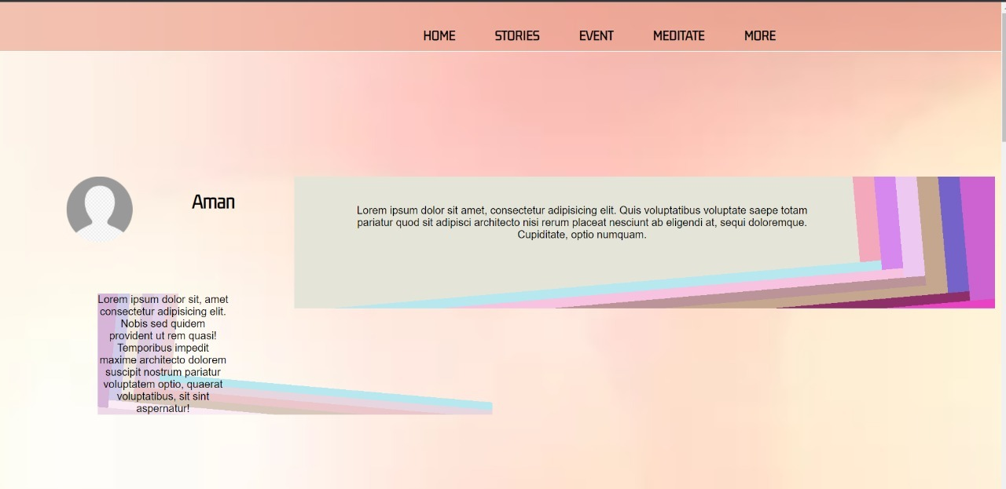
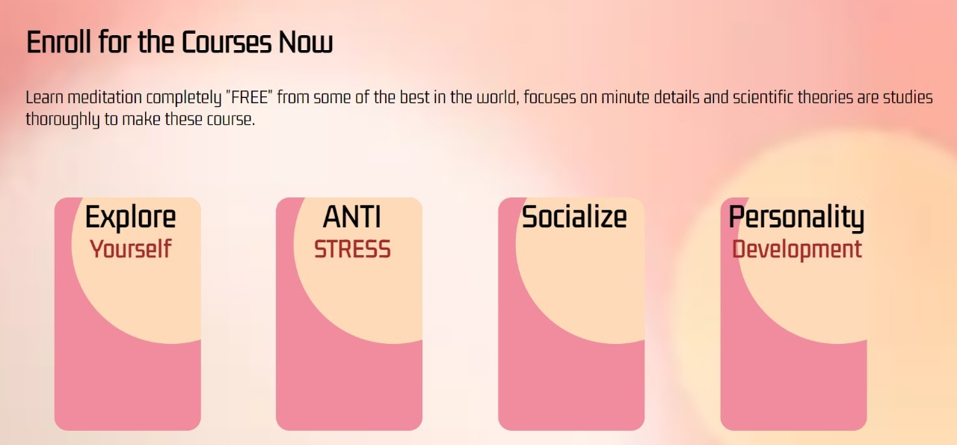
SNAPSHOTS

Slide 21
RESULT AND DISCUSSION
In recent years, mental health issues have become a major source of concern in our society due to the increases in its occurrence and the devastating effects it has on the individual, their loved ones, and society as a whole. According to a survey by the World Health Organization—Mental Health, approximately 350 million individuals suffer from depression yearly.
Digital health tools provide the opportunity to make health services accessible and more engaging. Specifically, websites are an attractive platform for delivering mental health interventions because of their ubiquitous nature coupled with their increased capacity to process and handle a large amount of data, deliver instant feedback, and share data with the healthcare providers and researchers.
There are many applications designed to support mental health issues. we collected reviews from user that use a combination of different approaches. We identified the strategies/theoretical background used in mental health apps and found that monitoring/tracking (feelings, thoughts, journals, or behaviors) are the most frequently employed strategy followed by mindfulness/meditation methods .Other strategies used in mental health

Slide 22
Our website hold great promise as interventions for addressing common mental issues. Although many people with mental health issues, their adherence level remains low. However, there is still a dearth of research to explain the reasons for low engagement. User experience and usability are two factors that determine the adoption and usage of website. Analyzing user reviews of website for mental health issues reveals user experience and what features users liked and disliked in the website and hence informs future web design and refinements. This research aims to analyze user reviews of publicly available mental health applications to uncover their strengths, weaknesses, and gaps, hence revealing why users are likely to cease using these applications.

Slide 23
CONCLUSION
The subject of psychiatric diagnosis highlights some key debates in the world of mental health, which also apply to how to treat people with mental health problems
Making sense of mental health problems, we have also been encouraged to start exploring the extent to which practitioners take account of all the different possible causes of mental health problems.
Website offer convenient and cost-effective interventions that have an ability to reach a more diverse population than traditional face-to-face psychological interventions. It is important that people with poststroke aphasia, a population with an increased risk of developing depression, are considered in future mental health website research. Failure to do so may mean that people with poststroke aphasia and mild to moderate depression may not be offered mental health treatment, or the options available to them may remain inaccessible, and therefore potentially nonbeneficial to them. In this project, Making sense of mental health problems, you have also been encouraged to start exploring the extent to which practitioners take account of all the different possible causes of mental health problems.

Slide 24


THANK YOU FOR LISTENING!

